Slide 1
CS5560 KDM Summer 2016 Summarization of Trending News from News Articles
Team 9
Instructor: Dr YugYung Lee Prasanna Muppidi (23)
TA: Mayanka Chandra Shekhar, Santhosh Mohan (24)
Naga Vadlamudi Anudeep Pandiri (29)
Vamshi Rajarikam (36)

Slide 2
Introduction
Topic: Summarization of trending topics in the world from various news articles.
News Articles:
a. New York Times
b. Google Trends
c. The Guardian
Technologies Used:
a. Languages: Java, Scala
b. IDE: Intellij Idea
c. Frameworks: Spark
d. Libraries: CoreNLP, SparkNLP, JSON, WordNet, SparkMl,LDA
e. APIS: Google Trends, Guardian, NYtimes, USAtoday, intellexer

Slide 3
Motivation
Every news articles site provides data about the trending news
Displaying and letting every user know about the latest or the trending news is very important sometimes.
For example, Earthquake. It’s very important for people to know about the status of the earthquake or status of people in particular locations.
To let the users know about the latest or trending news with so much ease is the main motivation of our application.
So, we want to make our website user friendly by providing all the news from different site at one place to make user convenience.

Slide 4
Objectives
Our application takes information regarding all the latest or trending news from various news articles using their particular APIs and displays the summarized data to the users.
Summarization is done using various NLPs.
The unstructured data which is collected from the news websites is processed using TF-IDF and the output data is structured.
This structured data is easily understandable by the users. It’s not required for the users to Login into the application and view the news.
The news which is displayed is clear cut without any unnecessary information making it easy for the users.
Collecting, Managing, Summarizing and Displaying all the trending news is the main objective of our application.

Slide 5
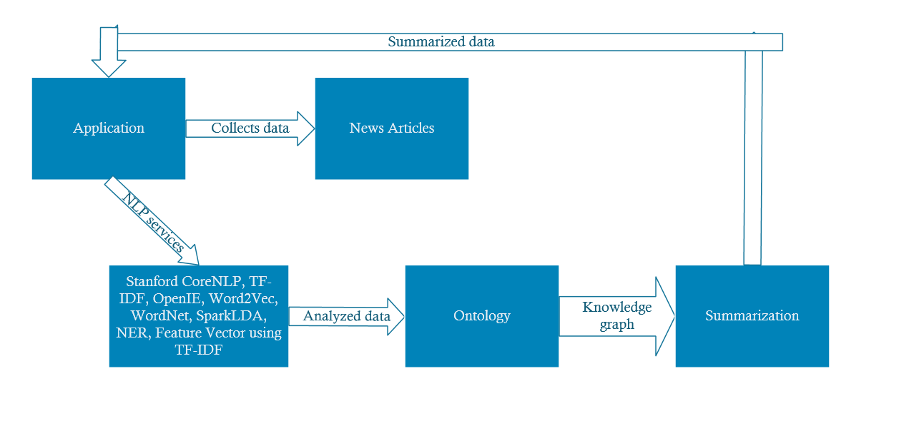
Architecture Diagram

Slide 6
Approach
Data Collection: There are many open source datasets available in the internet. There are mainly two types of data collection.
a. Static Data
b. Real Time Data using APIs
API:
Google Trends:
https://www.google.com/trends/api/stories/latest?cat=m&fi=15&fs=15&geo=US&ri=300&r s=15&tz=300
Newyork Times:
https://api.nytimes.com/svc/search/v2/articlesearch.json?api-key=1069bc25bff24ebf8cf3dbae1133e000&q=tech&sort=newest&fl=lead_paragraph&page =0

Slide 7
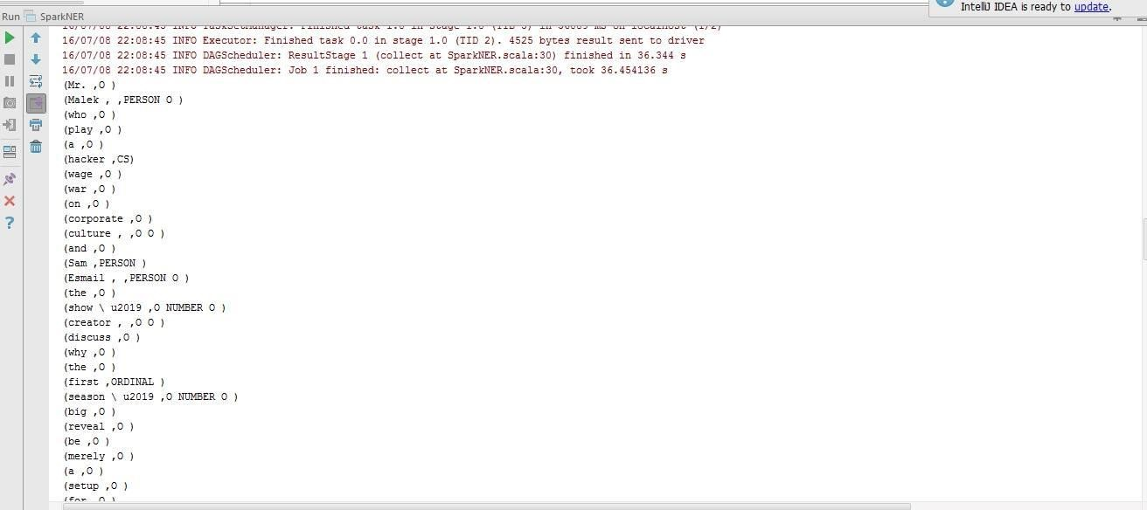
NER

Slide 8
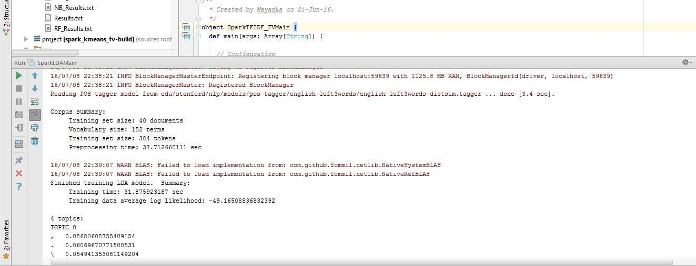
Spark LDA

Slide 9
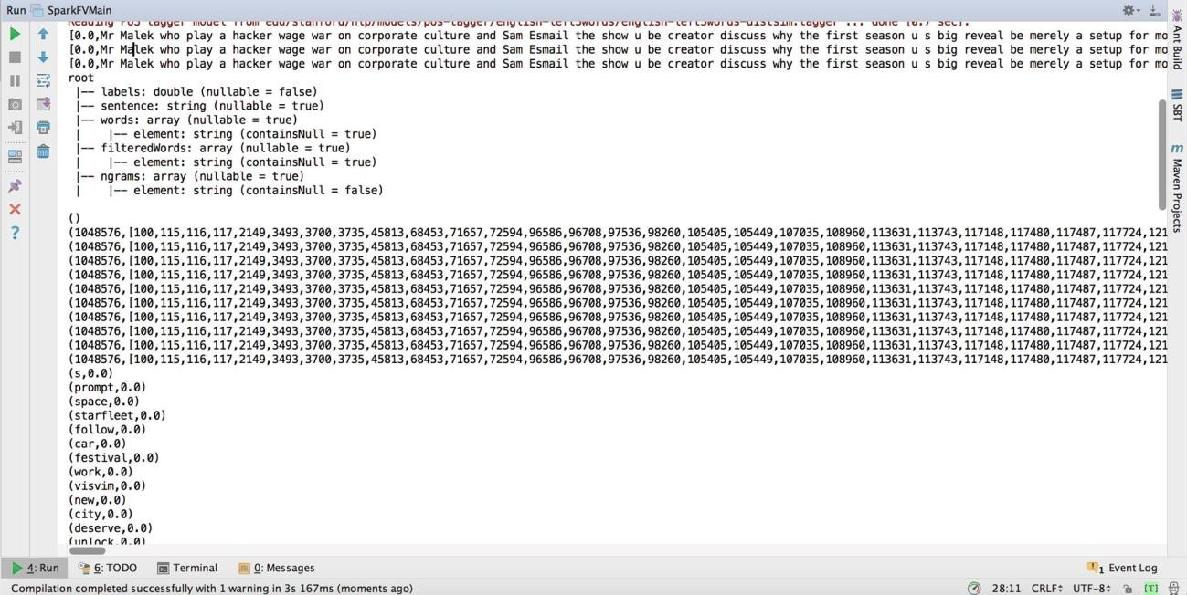
Feature Vector with TF-IDF

Slide 10
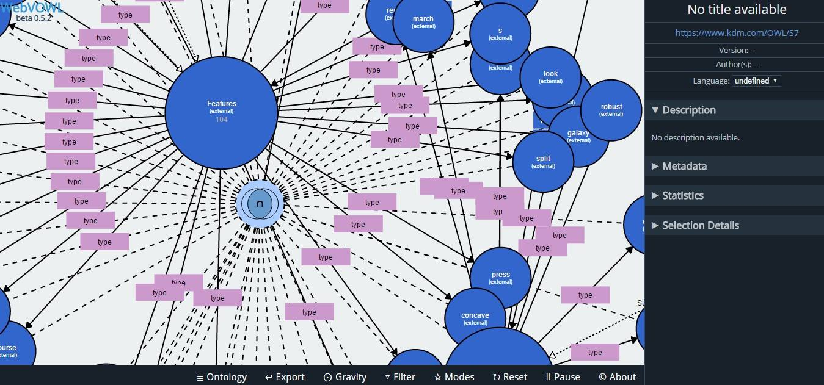
Ontology

Slide 11
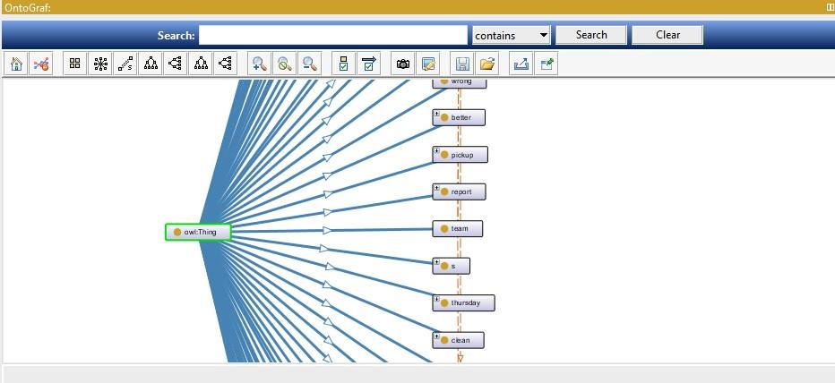
Ontology

Slide 12
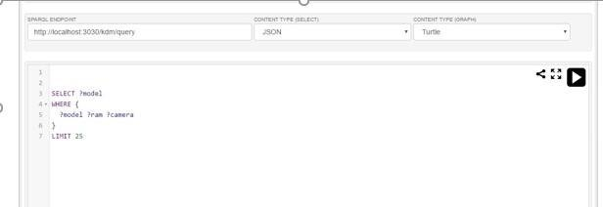
Jena Fuseki
Jena Fuseki:
Output Screenshot:

Slide 13
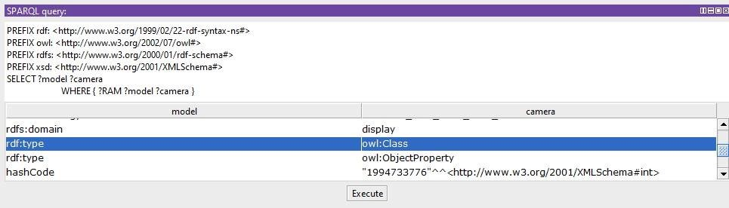
SparkQL

Slide 14
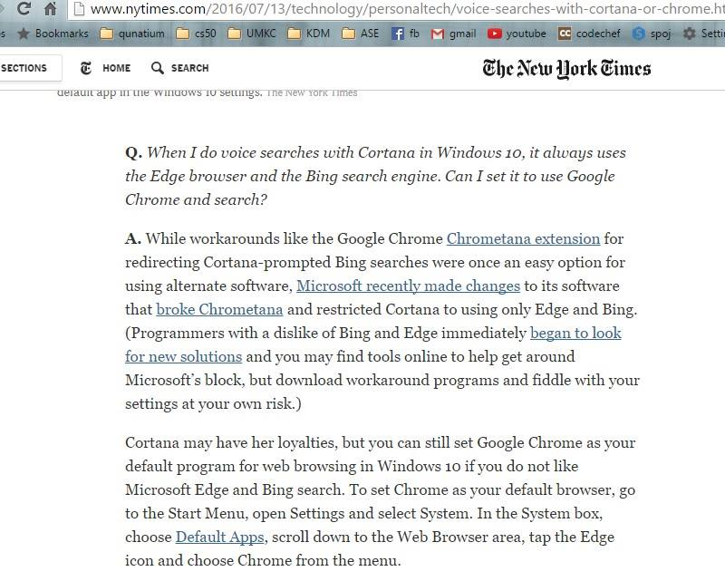

Slide 15
